Slide 1







EMERGING SKILLS
Shiv Modi
24th May 2023

Slide 2



OUTLINE
Executive Summary
Introduction
Methodology
Results
Visualization – Charts
Dashboard
Discussion
Findings & Implications
Conclusion
Appendix

Slide 3

EXECUTIVE SUMMARY
The primary objective of this analysis is to identify and understand the emerging skills in the IT industry.
By examining data from various sources, we aim to uncover the skills that are becoming increasingly important and in demand.
We will analyze current programming language, database, platform and web frame popularity as well as the possibility of upcoming skills regarding programming language, database, platform and web frame
We will present no. of job openings regarding these skills and job locations
We will also investigate the salary offered for various programming language skills

Slide 4

INTRODUCTION
In today's fast-paced and ever-evolving world of technology, staying ahead of the curve is essential for organizations to remain competitive.
Our organization, a global IT and business consulting services firm, is committed to maintaining our reputation as an industry leaders in IT solutions and leveraging the expertise of our highly experienced IT consultants.
To achieve this, we recognize the importance of regularly analyzing data to identify emerging trends and anticipate future skill requirements.
Analyzing emerging skills is essential for our organization's success and competitiveness in the IT industry.
It empowers us to adapt, upskill, and deliver value to our clients, while attracting and retaining top talent.
As a Data Analyst, I have been entrusted with collecting data from various sources and conducting an in-depth analysis to identify the emerging skills that will shape the IT industry in the coming years.

Slide 5

METHODOLOGY
We used job posting data from following dataset. It will help to analyze current skills need.
https://www.kaggle.com/datasets/promptcloud/jobs-on-naukricom
We took a survey from people doing jobs in a firm. It will explain current and future skills requirements.
https://cf-courses-data.s3.us.cloud-object-storage.appdomain.cloud/IBM-DA0321EN-SkillsNetwork/LargeData/m4_survey_data.sqlite
Following link provides annual salary for each technical skills
https://cf-courses-data.s3.us.cloud-object-storage.appdomain.cloud/IBM-DA0321EN-SkillsNetwork/labs/datasets/Programming_Languages.html

Slide 6
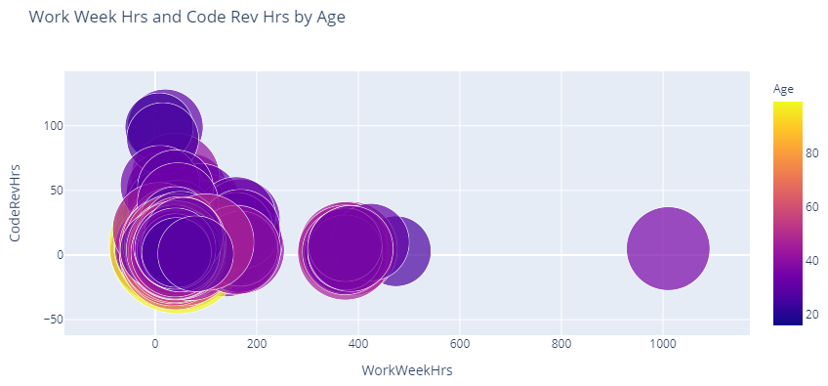
RESULTS

Slide 7
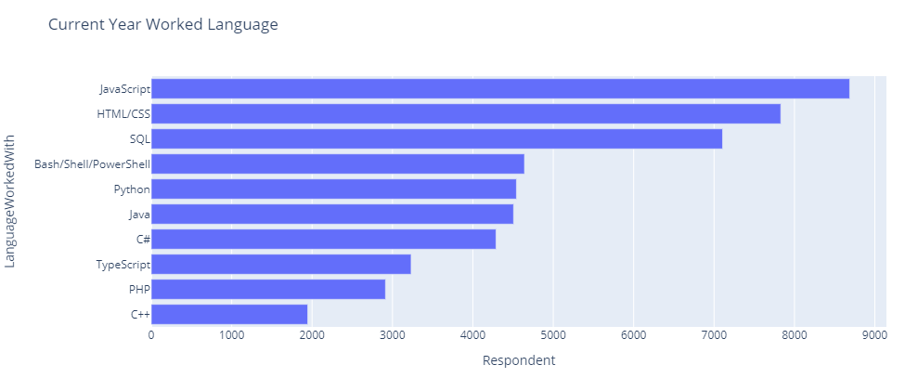
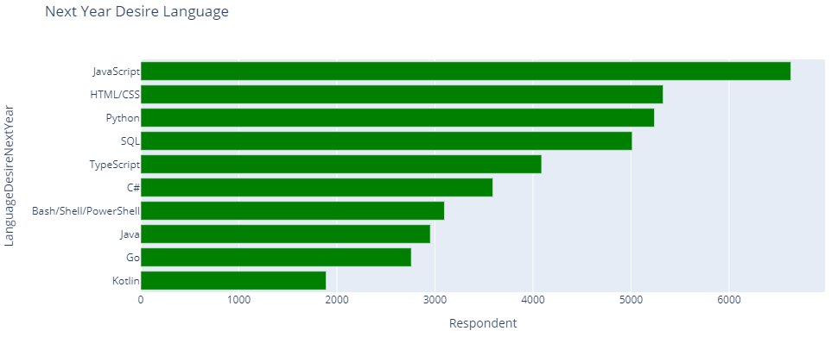
PROGRAMMING LANGUAGE TRENDS
Current Year
Next Year

Slide 8
PROGRAMMING LANGUAGE TRENDS - FINDINGS & IMPLICATIONS
Findings
Java Scripts and HTML/CSS is most required skills set now and in future
Python and SQL skills will be desired in future
There will be new emerging skills like Go and Kotlin in near future
Implications
Practice sessions on Java Scripts, HTML/CSS
Hire desired skills like Python and SQL in near future
Brainstorming sessions on new skills Go and Kotlin

Slide 9
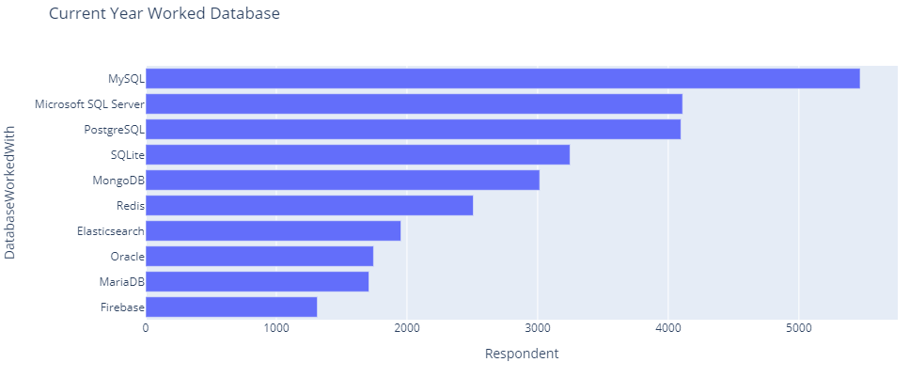
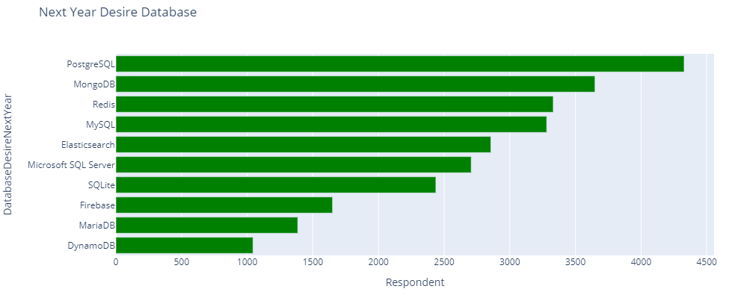
DATABASE TRENDS
Current Year
Next Year

Slide 10
DATABASE TRENDS - FINDINGS & IMPLICATIONS
Findings
MySQL is most current working database
PostgreSQL, MongoDB, Redis, Elasticsearch databases will be required in next year
New DynamoDB, Firebase databases will be emerged
Implications
Practice sessions on MySQL
Hire desired skills like PostgreSQL, MongoDB in near future
Brainstorming sessions on new skills DynamoDB, Firebase

Slide 11

DASHBOARD
https://ap2.ca.analytics.ibm.com/bi/?perspective=dashboard&pathRef=.my_folders%2FCapstone&action=view&mode=dashboard&subView=model00000188429572c0_00000000

Slide 12
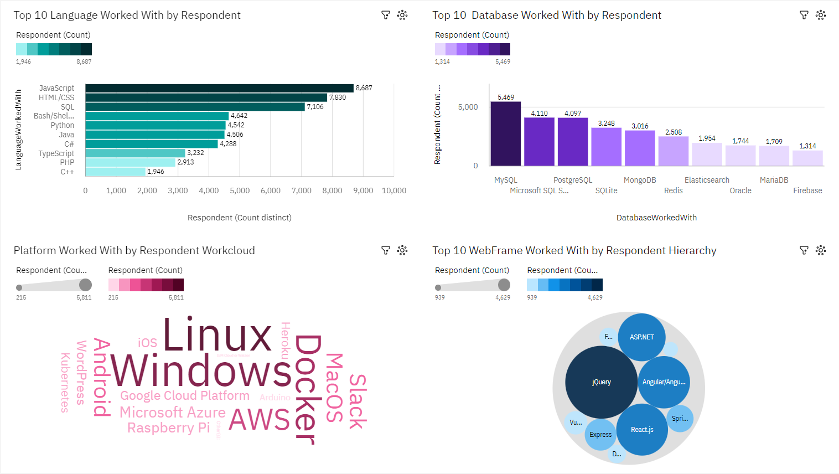
CURRENT TECHNOLOGY USAGE

Slide 13
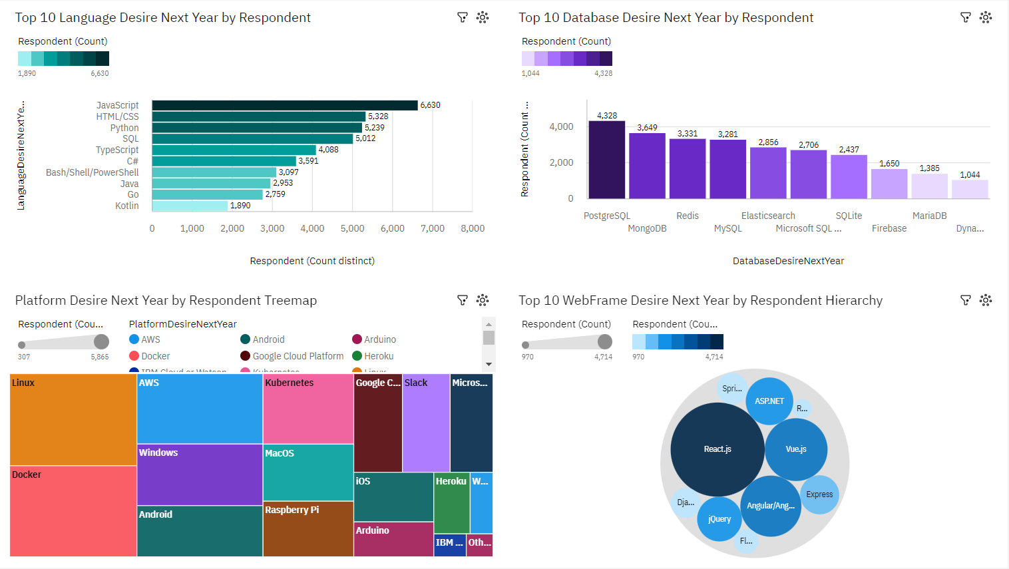
FUTURE TECHNOLOGY TREND

Slide 14
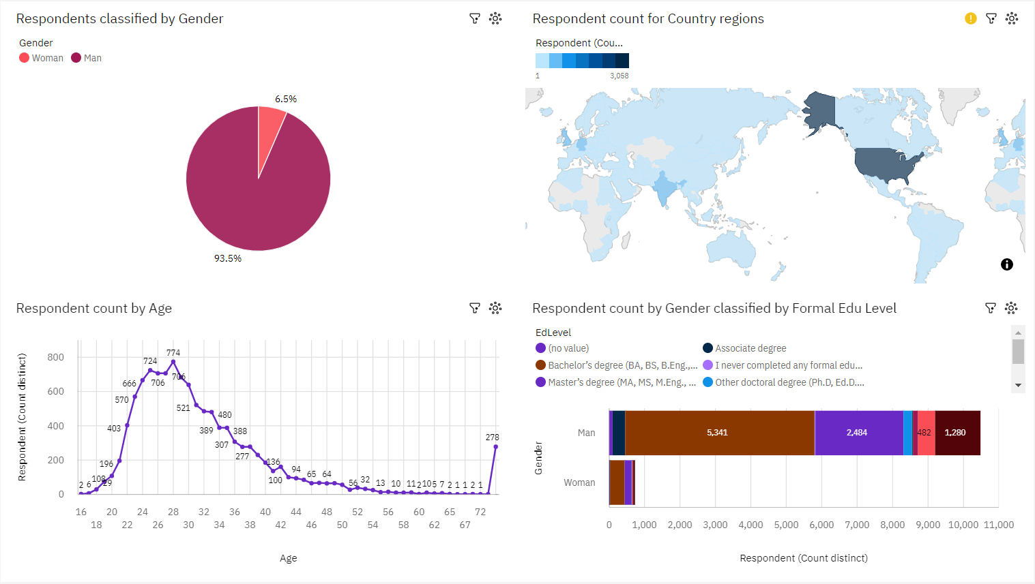
DEMOGRAPHICS

Slide 15
DISCUSSION
Docker will be the more desired platform next year, replacing Windows
jQuery will be replaced by React.js next year
Hire based on skills in platform Linux, Docker and web frame React.js
Next hiring should be from other than the US and keeping the gender ratio decreasing

Slide 16
OVERALL FINDINGS & IMPLICATIONS
Findings
Gender ratio is large
Maximum responders are from 24-32 age
Maximum responders are from USA
Implications
Empower women by hiring and training-upskilling current women
Fresh mind work active, initiate collage student internship
Extend job applications from overseas

Slide 17

CONCLUSION
We must practice current skills while initiating training for upcoming new skills
Brainstorming sessions to enhance current skills, which will also dominate in future
Learning sessions can be conducted to excel in upcoming skills
Increase hiring of young minds
Reduce gender ratio and enhance diversity from overseas in firm

Slide 18
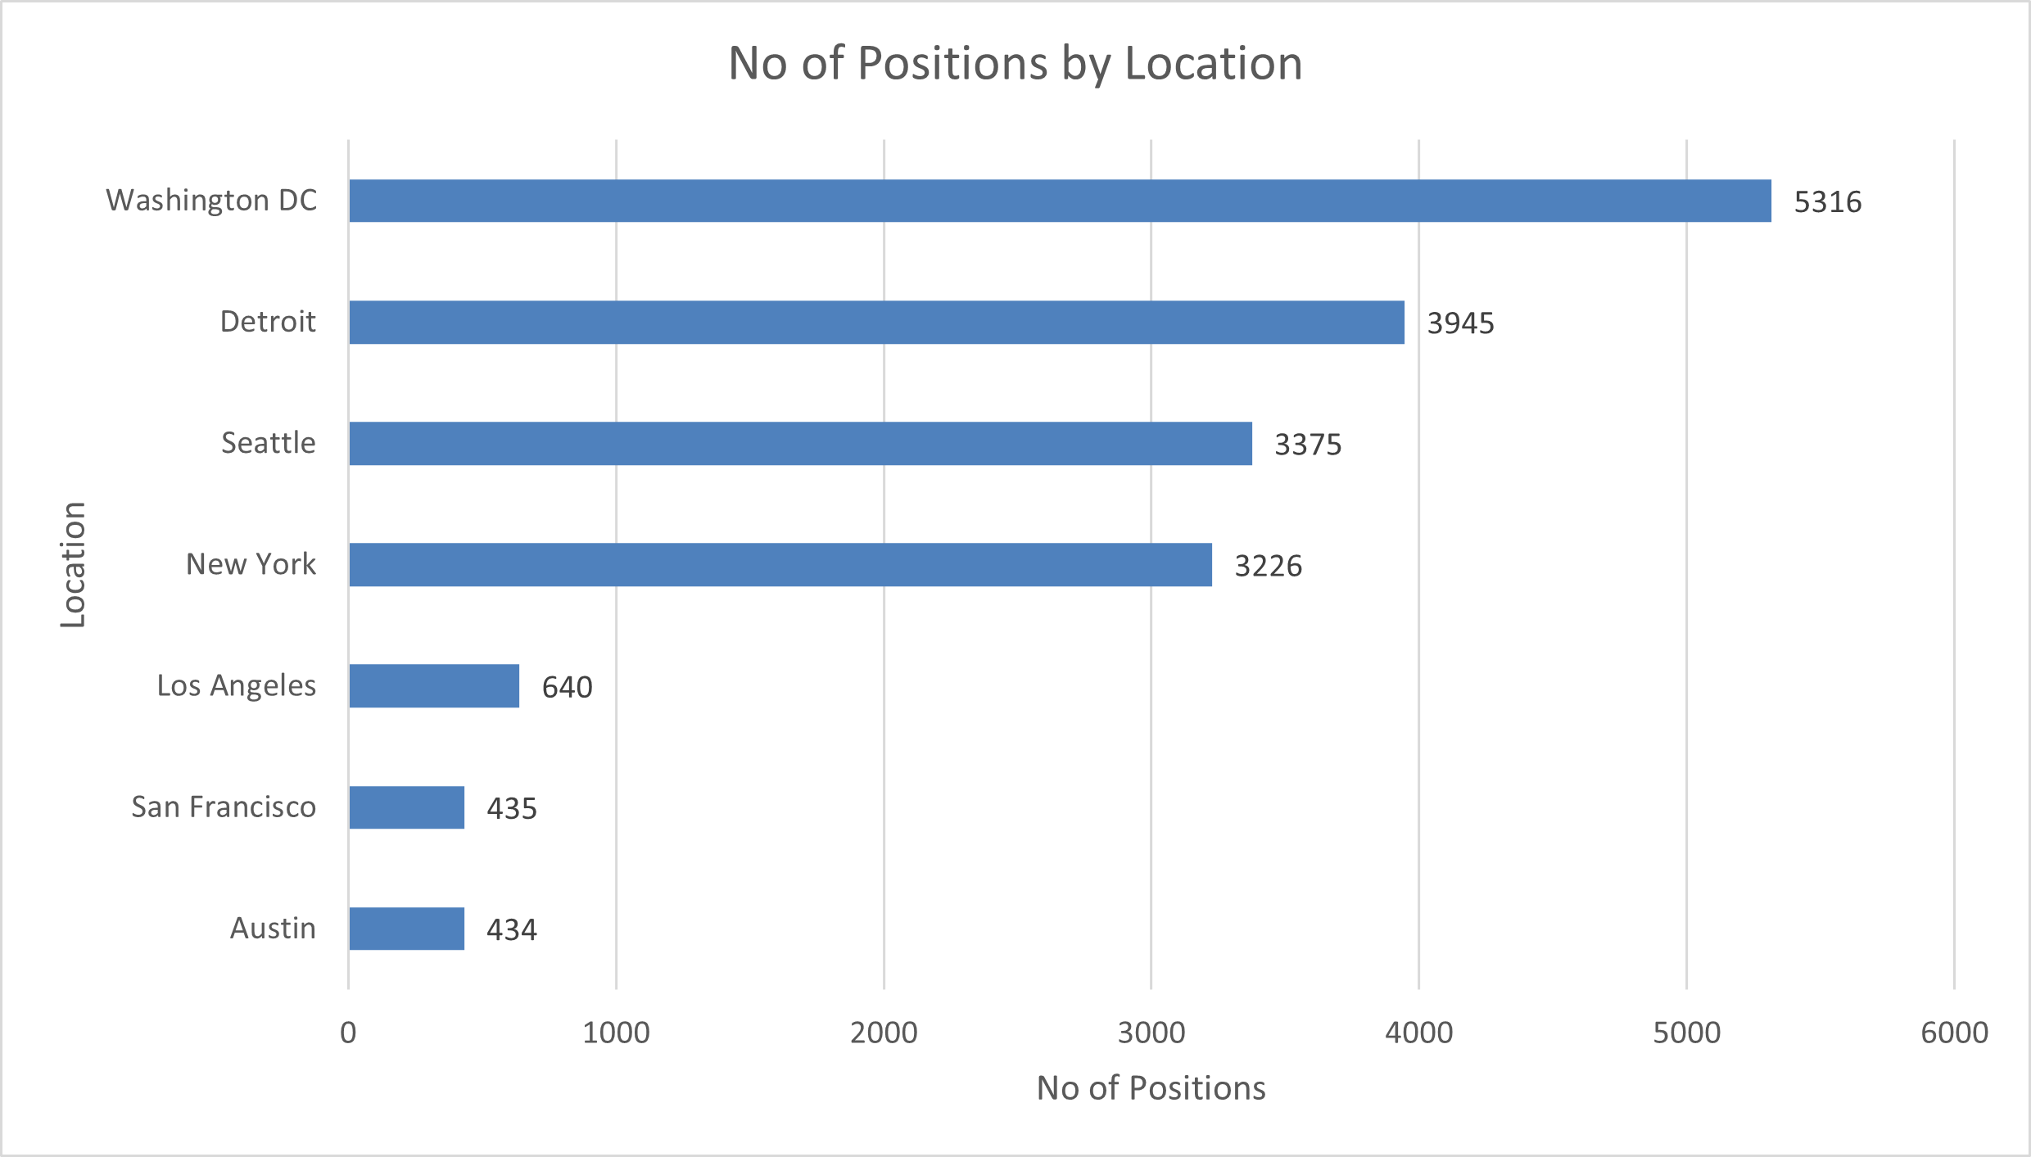

APPENDIX

Slide 19
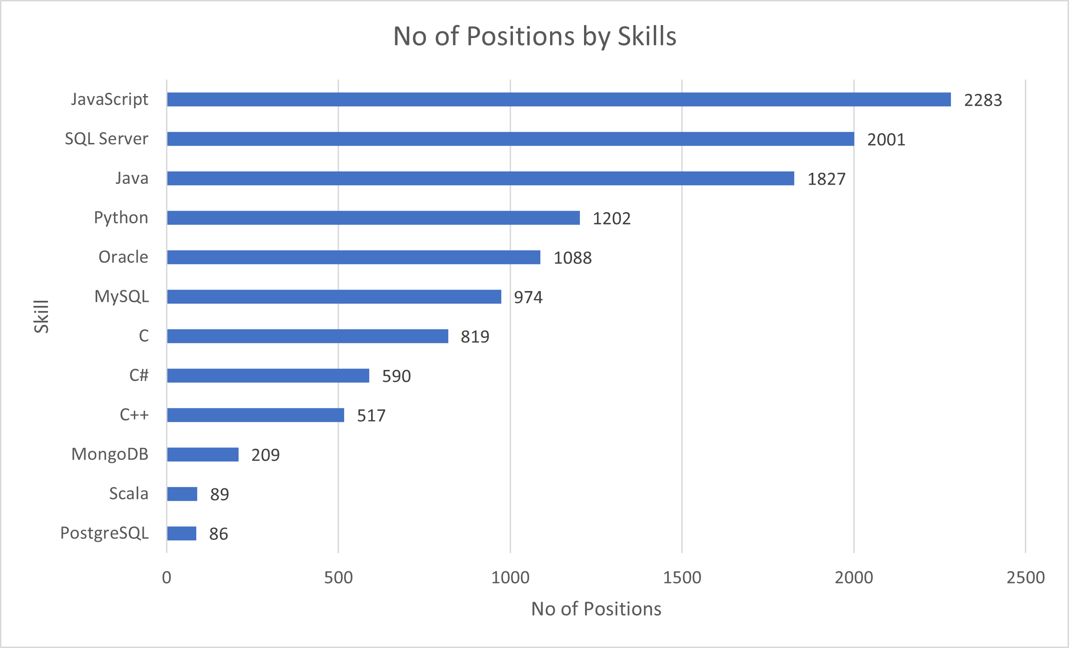
JOB POSTINGS

Slide 20
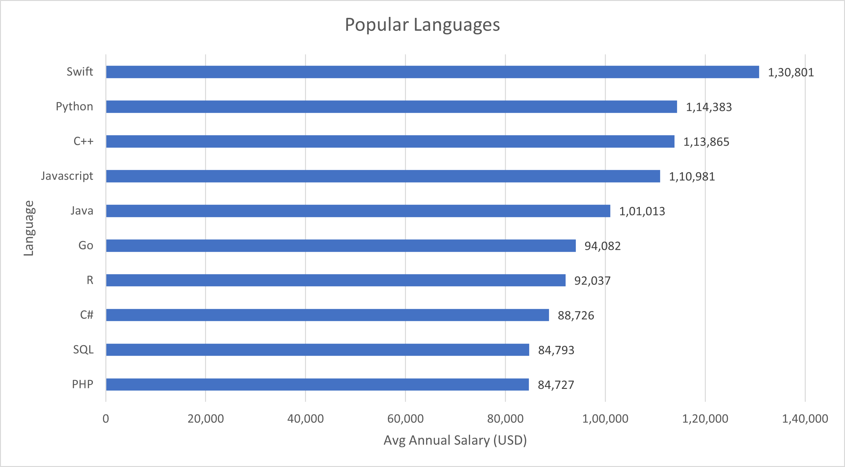
POPULAR LANGUAGES

